Slide 1
Pickpocketing
(a presentation by MCPF Penang)
www.mcpfpg.org

Slide 2
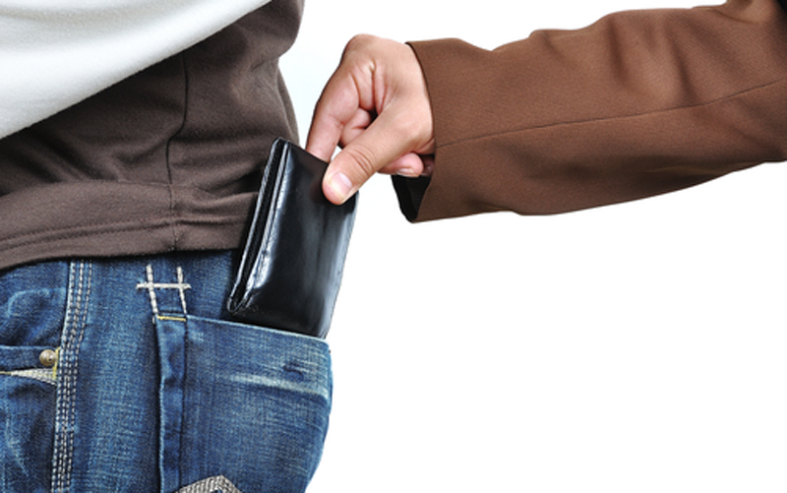
Pickpocketing // How Can It Happen?
www.mcpfpg.org
Pickpocketing may happen in crowded areas;
Persons flaunting wealth, or other valuables may attract pickpockets;
Pickpockets may “accidently” bump into you;
Pickpockets operate when the Target is distracted.

Slide 3
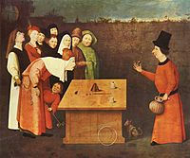
Pickpocketing // Preventive Measures
www.mcpfpg.org
Do Not carry excessive cash in public;
Do Not flaunt your valuables to draw unnecessary attention;
Never leave your valuables unattended, especially in crowded places;
Check your wallets, handbag and valuables if someone bumps into you unnecessarily.

Slide 4
Pickpocketing // Preventive Measures
www.mcpfpg.org
Be on guard and alert for various scams and confidence tricksters;
Do not doze off in the bus or MRT train and leave your belongings unattended;
Be wary of strangers creating a commotion or “accidentally” spilling something on you.

Slide 5
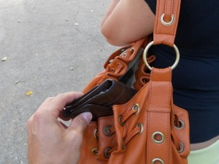
Pickpocketing // Precautions for Ladies
www.mcpfpg.org
Pickpockets prefer to target ladies with handbags especially when carried with clasps facing outwards.
Carry your bag tightly under your arm and always keep it properly fastened.
Sling your handbag in front of you so that you can keep an eye on it.
Never leave your handbag in a shopping basket or trolley.

Slide 6
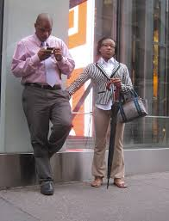
Pickpocketing // Precautions for Men
www.mcpfpg.org
Pickpockets like to target men who keep wallets in the rear trousers or chest pockets;
Keep your wallet in your side trousers pocket;
Always tap your pockets containing your wallet upon getting bumped into “accidently”.

Slide 7
Pickpocketing // If You Are A Victim…
www.mcpfpg.org
React quickly without panicking. Panicking only gives the pickpocket more time to get away with the crime.
Inform all respective banks that you have account in.
Cancel all credit cards if your wallet/purse has been taken.
Report to the Police immediately, this will also raise awareness.
Fill out an identity theft affidavit to protect yourself against any new accounts that the pickpocket may open and use in your name.

Slide 8
Pickpocketing
A short Awareness Presentation brought to you by:
Malaysian Crime Prevention Foundation (Penang Chapter)
Visit us at www.mcpfpg.org for more information.

