Slide 1
Housebreaking
(a presentation by MCPF Penang)
www.mcpfpg.org

Slide 2
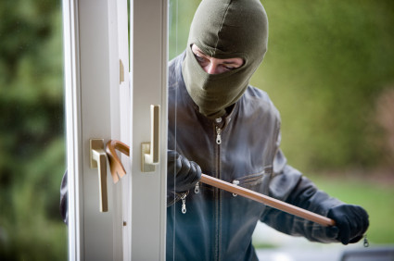
Housebreaking // How Can It Happen?
www.mcpfpg.org
Housebreaking occurs when the Intruder:
Forces open windows, grilles, gates, or doors! | Gains entry through the refuse chute, false ceiling or ventilation openings.
Cuts padlocks, and/or grilles. | Gains entry through neighbouring house/shop.
Gains entry by using household tools left outside the house.

Slide 3
Housebreaking // Preventive Measures
www.mcpfpg.org
Lock all doors and windows when leaving the home. (Even for a short while)
Do not hide keys outside the house. It is risky, dangerous and gives anyone who finds the keys access to your house!
Do not leave notes outside the house announcing you are away.
Leave a light or radio on at night to give an impression that the occupants are home.

Slide 4
Housebreaking // Preventive Measures
www.mcpfpg.org
Cancel all deliveries(e.g. newspapers, magazines) when you are away.
Change all locks when your house keys are lost or stolen.
Request immediate neighbours to keep an eye on your house while you are away.
Inform your Neighbourhood Police Centre (NPC) of your absence if you are going away from home.

Slide 5
Housebreaking // Hints
www.mcpfpg.org
Keep large sums of cash in banks and expensive jewelries in safe deposit boxes.
Install security alarm system.
Keep your handphone within easy reach, be contactable.
Keep a lookout in your neighbourhood for any suspicious person(s) who are loitering. Call the Police at ‘999’ for assistance.

Slide 6
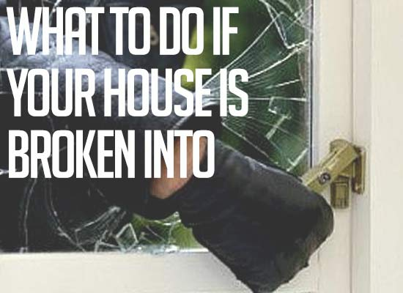
Housebreaking // What To Do If Your House is Broken Into?
www.mcpfpg.org

Slide 7
Housebreaking // What To Do If Your House is Broken Into?
www.mcpfpg.org
Leave the house and call 999. Some burglars will hide in your house upon knowing you have returned. Take caution. Leave the house immediately and call the Police immediately.
Don’t touch anything. Some burglars wear gloves, but not all do. Fingerprints are strong evidence, but they are delicate and easily destroyed. Inform the police if you find something that may belong to the burglar, but do not touch it.

Slide 8
Housebreaking // What To Do If Your House is Broken Into?
www.mcpfpg.org
Take Inventory Make a list of items that were stolen, and property that was damaged. This list is needed for Law Enforcement and Insurance companies. Take photos of any damaged property, and the make model, and serial numbers of electronics.
Prepare for the future Review your home’s security, and survey it. You should be provocative and educate yourself about home security options. There are many affordable security options today.

Slide 9
Housebreaking
A short Awareness Presentation brought to you by:
Malaysian Crime Prevention Foundation (Penang Chapter)
Visit us at www.mcpfpg.org for more information.

